Slide 1


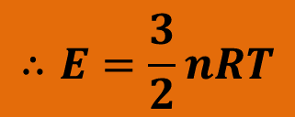

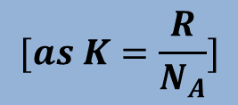
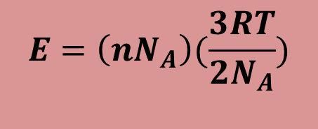
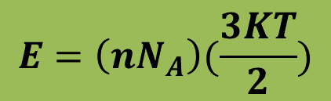
Internal Energy of an Ideal Gas
Consider n mole of monatomic ideal gas. The internal energy of the gas is the sum of the translational kinetic energies of the atoms.
If N is the total number of atoms then the internal energy,
$$E=NK_{avg}$$
$$E=nN_{A}K_{avg}$$
$$∴E=\frac{3}{2}nRT$$
$$E=\left(nN_{A}\right)(\frac{3KT}{2})$$
and ΔE_{int} = $\frac{3}{2}nR\text{Δ}T$
$$E=\left(nN_{A}\right)(\frac{3RT}{2N_{A}})$$
Thus the internal energy E_{int} of an ideal gas is a function of the gas temperature only.
$$[as K=\frac{R}{N_{A}}]$$

Slide 2
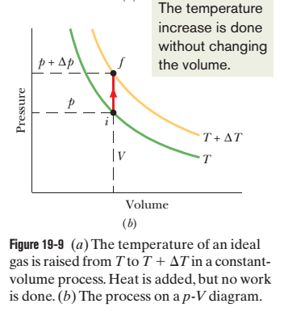
Molar Specific Heat at Constant Volume

Slide 3

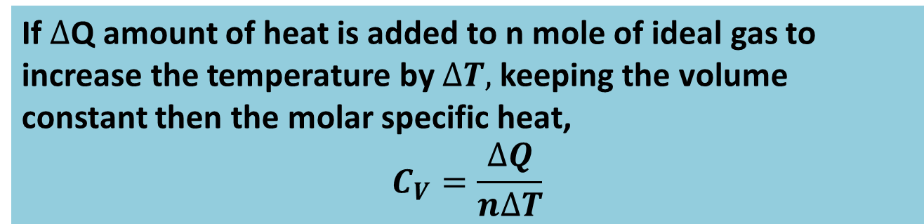


If $∆$Q amount of heat is added to n mole of ideal gas to increase the temperature by $∆T,$keeping the volume constant then the molar specific heat,
$$C_{V}=\frac{∆Q}{n∆T}$$
$$∆Q=nC_{V}∆T$$
The Work done at constant volume,
$$∆W=0$$
The change in internal energy of the system,
$$∆E=\frac{3}{2}nR∆T$$

Slide 4
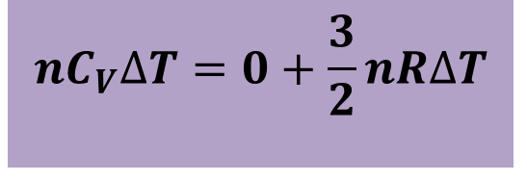

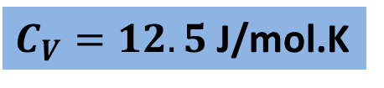
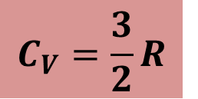
From the 1st law of thermodynamics,
$$∆Q=∆W+∆E$$
$$nC_{V}∆T=0+\frac{3}{2}nR∆T$$
$$C_{V}=\frac{3}{2}R$$
$C_{V}=12.5$J/mol.K

Slide 5
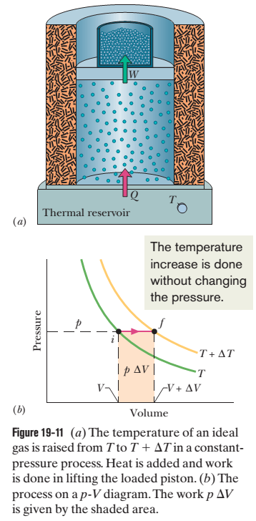
Molar Specific Heat at Constant Pressure

Slide 6

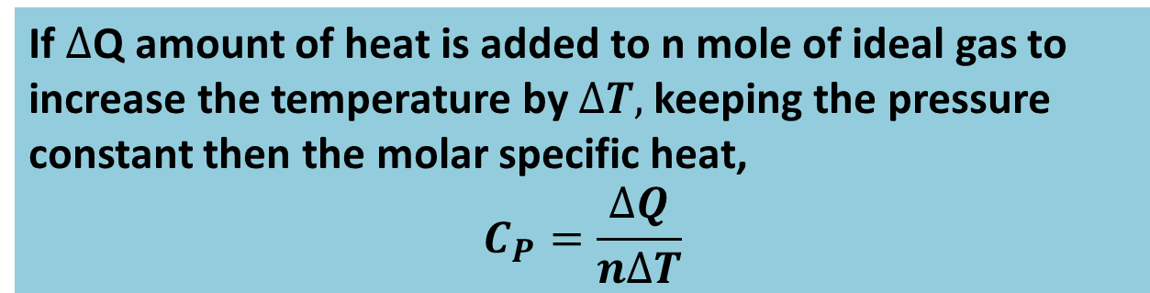


If $∆$Q amount of heat is added to n mole of ideal gas to increase the temperature by $∆T,$keeping the pressure constant then the molar specific heat,
$$C_{P}=\frac{∆Q}{n∆T}$$
$$∆Q=nC_{P}∆T$$
The Work done at constant pressure,
$$∆W=P∆V$$
The change in internal energy of the system,
$$∆E=\frac{3}{2}nR∆T$$

Slide 7
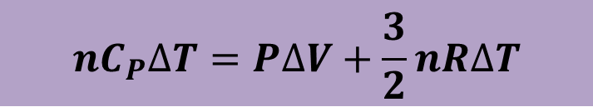
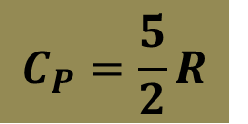

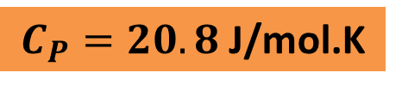
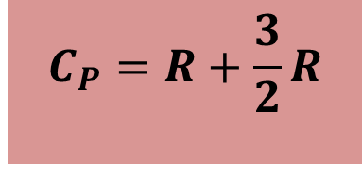

From the 1st law of thermodynamics,
$$∆Q=∆W+∆E$$
$$nC_{P}∆T=P∆V+\frac{3}{2}nR∆T$$
$$nC_{P}∆T=nR∆T+\frac{3}{2}nR∆T$$
$$C_{P}=R+\frac{3}{2}R$$
$$C_{P}=\frac{5}{2}R$$
$$C_{P}=20.8 \text{J}\text{/}\text{mol}\text{.}\text{K}$$

Slide 8
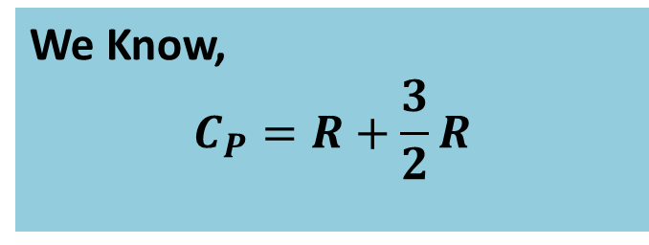

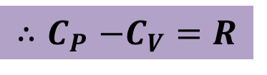
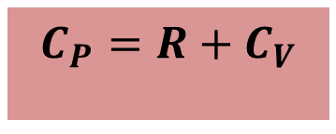
Relation Between $C_{P}$and $C_{V}$
We Know,
$$C_{P}=R+\frac{3}{2}R$$
$$C_{P}=R+C_{V}$$
$${∴C}_{P}−C_{V}=R$$
Thus C_{p} is greater than the molar specific heat at constant volume C_{V}

Slide 9

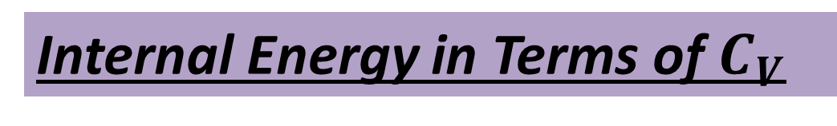

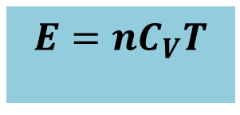
Internal Energy in Terms of $C_{V}$
Internal energy,
$$E=\frac{3}{2}nRT$$
$$E=nC_{V}T$$
The change in internal energy,
$$∆E=nC_{V}∆T$$

Slide 10
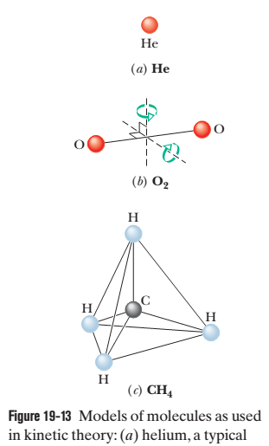
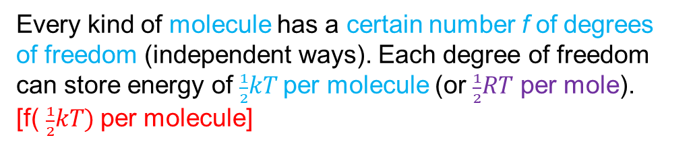
Degrees of freedom and molar specific heats: E_{int} = ( $\frac{f}{2})nRT$ and C_{V} = ($\frac{f}{2})R$
Let us try to explain that molecules with more than one atom can store internal energy in forms other than translational kinetic energy.
Figure 19-13 shows common models of helium (a monatomic molecule, containing a single atom), oxygen (a diatomic molecule, containing two atoms), and methane (a polyatomic molecule).
James Clerk Maxwell introduced the theorem of the equipartition of energy:
Every kind of molecule has a certain number f of degrees of freedom (independent ways). Each degree of freedom can store energy of $\frac{1}{2}kT$per molecule (or $\frac{1}{2}RT$ per mole).
[f( $\frac{1}{2}kT)$per molecule]

Slide 11
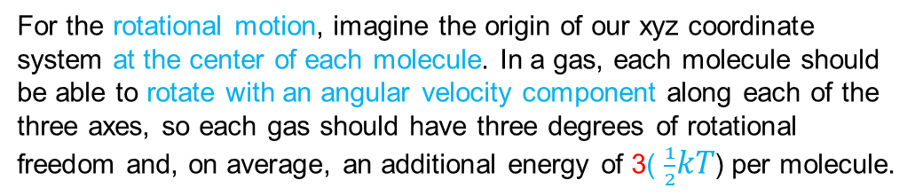
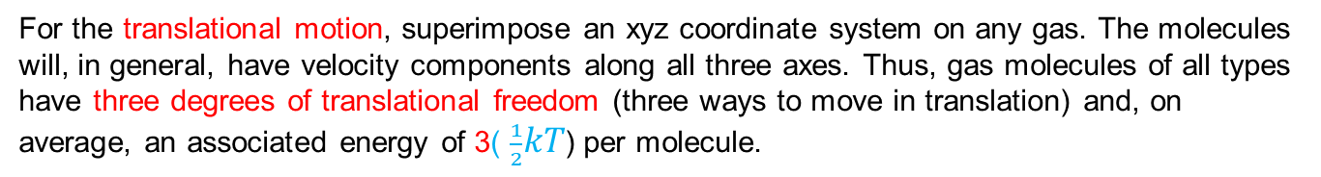
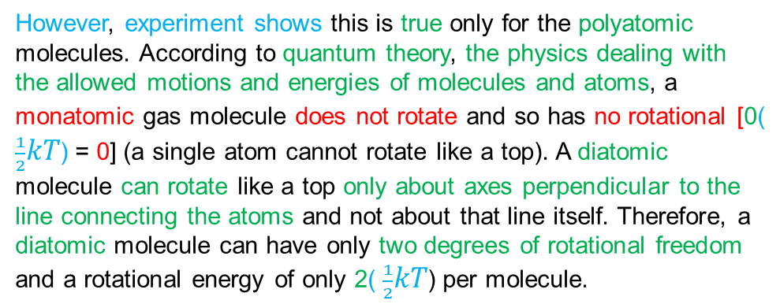
For the translational motion, superimpose an xyz coordinate system on any gas. The molecules will, in general, have velocity components along all three axes. Thus, gas molecules of all types have three degrees of translational freedom (three ways to move in translation) and, on average, an associated energy of 3( $\frac{1}{2}kT$) per molecule.
For the rotational motion, imagine the origin of our xyz coordinate system at the center of each molecule. In a gas, each molecule should be able to rotate with an angular velocity component along each of the three axes, so each gas should have three degrees of rotational freedom and, on average, an additional energy of 3( $\frac{1}{2}kT$) per molecule.
However, experiment shows this is true only for the polyatomic molecules. According to quantum theory, the physics dealing with the allowed motions and energies of molecules and atoms, a monatomic gas molecule does not rotate and so has no rotational [0( $\frac{1}{2}kT$) = 0] (a single atom cannot rotate like a top). A diatomic molecule can rotate like a top only about axes perpendicular to the line connecting the atoms and not about that line itself. Therefore, a diatomic molecule can have only two degrees of rotational freedom and a rotational energy of only 2( $\frac{1}{2}kT$) per molecule.

Slide 12
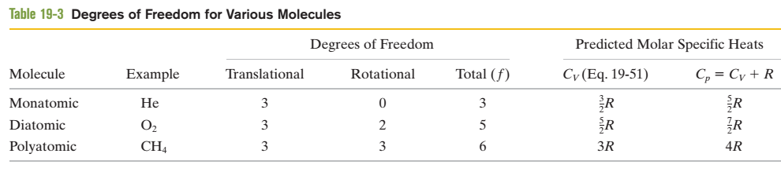

To extend our analysis of molar specific heats to ideal diatomic and polyatomic gases, it is necessary to retrace the derivations of that analysis in detail. First, we replace E_{int} = (3/2) nRT
with E_{int} = (f/2) nRT, where f is the number of degrees of freedom [Table 19-3]. Doing so leads to the prediction
C_{V} = ($\frac{f}{2})R$
This agrees for monatomic gases (f = 3). As Table 19-3 shows, this prediction also agrees with experiment for diatomic gases (f =5), but it is too low for polyatomic gases (f = 6 for molecules comparable to CH₄).

Slide 13



47. The temperature of 2.00 mol of an ideal monatomic gas is raised 15.0 K at constant volume. What are (a) the work W done by the gas, (b) the energy transferred as heat Q, (c) the change ΔE_{int} in the internal energy of the gas, and (d) the change ΔK in the average kinetic energy per atom?
Solution:
Here, ΔT= 15 K
n = 2.00 mol
k = $\frac{R}{N_{A}}=\frac{8.31 J/mol−K}{6.023 x {10}^{23}/mol} = 1.38 x {10}^{−23 }J/K$
ΔV = V - V = 0
(a) W = pΔV = p(0) = 0
(b) Q = nC_{V}ΔT = n ($\frac{3}{2})R$ ΔT = 2.00 ($\frac{3}{2})8.31 ($15) = 373.95 J
[C_{V} = ($\frac{3}{2})R ]$
[$R=8.31 J/mol−K]$
(c) ΔE_{int} = Q – W = 373.95 – 0 = 373.95 J
(d) ΔK = ($\frac{3}{2})k$ΔT = ($\frac{3}{2})(1.38 x {10}^{−23})$15 = 31.05 $x {10}^{−23}$ J

Slide 14

48. When 20.9 J was added as heat to a particular ideal gas, the volume of the gas changed from 50.0 cm³ to 100 cm³ while the pressure remained at 1.00 atm. (a) By how much did the internal energy of the gas change? If the quantity of gas present was 2.00x10⁻³ mol, find (b) C_{p} and (c) C_{V}.
Solution:
Here, Q = 20.9 J
ΔV = (100 – 50) cm³ = 50 cm³ =50(10⁻² m)³ = 50x10⁻⁶ m³
p = 1.00 atm = 1x10⁵ Pa
n = 2.00x10⁻³ mol
(a) ΔE_{int} = Q – W = Q – p ΔV = 20.9 – 1x10⁵(50x10⁻⁶) = 20.9 – 5.0 = 15.9 J
(b) Q = nC_{p}ΔT
[p = constant]
C_{p} =$\frac{Q}{n∆T}$

Slide 15

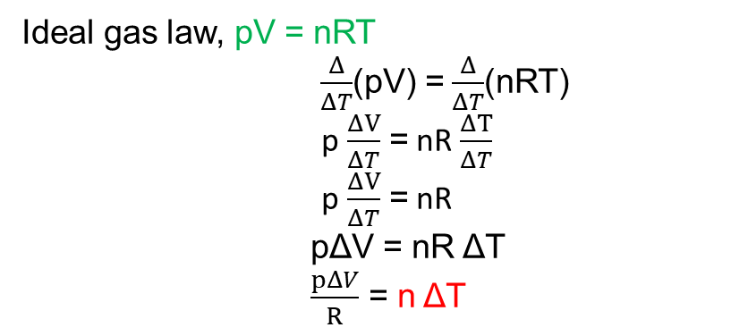
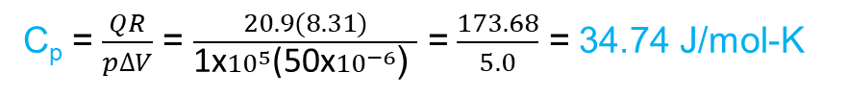
Ideal gas law, pV = nRT
$\frac{Δ}{ΔT}$(pV) = $\frac{Δ}{ΔT}$(nRT)
p $\frac{ΔV}{ΔT}$ = nR $\frac{ΔT}{ΔT}$
p $\frac{ΔV}{ΔT}$ = nR
pΔV = nR ΔT
$\frac{pΔV}{R}$ = n ΔT
C_{p} =$\frac{Q}{\frac{pΔV}{R}}$
C_{p} =$\frac{QR}{p∆V}$ = $\frac{20.9(8.31)}{\text{1}\text{x}{10}^{5}\text{(50}\text{x}{10}^{−6}\text{) }}$ = $\frac{173.68}{5.0}$ = 34.74 J/mol-K
(c) C_{p} – C_{V} = R
C_{V} = C_{p} – R = 34.74 – 8.31 = 26.43 J/mol-K

